Slide 1
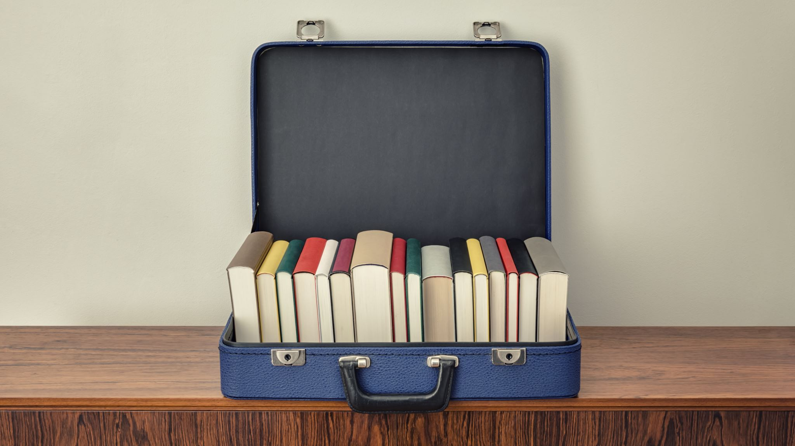
Keeping your storage device tidy.
If you keep it tidy you can find things easily.
The device could be lots of things like;
A computer your phone or tablet or external storage device.

Slide 2
The root folder (folder used to be called a directory) of a USB storage device (Pen). This Pen has nothing on it.
This could be any type of storage device.

Slide 3
The “C” Drive of my HP Laptop.

Slide 4
Temp Folder.
On a device It is normal to have a folder called “Temp”. This used for files that you only require temporally.

Slide 5
Making a Folder.
I am using Windows 11, and making folders is slightly different but if you poke around you will figure it out on other devices.
This is how I do it, I hold the Windows key and press E to get into Windows Explorer. I select the drive that I want the folder on and in the top left hand corner click on New it opens a box and select Folder.
A box will open with New Folder in it and the text is highlighted the curser will be flashing and you can now type your new folders name that could be for example “Shopping List”.

Slide 6
Folders on other devices.
APPLE.
Use the Files app on your iPhone, iPad, or iPod touch - Apple Support
ANDROID.
How to Create Folders in Android (makeuseof.com)

Slide 7
I hope this has helped.
This cartoon is not a joke the kids can help us a lot.
They usually just play around and get results.
They rarely damage something seriously.
So why don’t you give it a try doing things with your device and you will learn.
If you have any questions now is the time to ask.

