Slide 1
Probus Warragul Tarago Computer Group.
Friday 10th May 2024

Slide 2
Questions and Answers. Ask your question and any one can help.
Questions,

Slide 3
Take notes of things you learn about Devices.
I have been going to computer classes for years and always learn something new.
I use an exercise book to write the tips in its is very handy to look back on, the mere act of writing it helps you to remember it any way.

Slide 4
Folders (used to be called directories).
It is a VERY good idea to keep order on your device (phone tablet computer) by putting files into folders so that you can find them.
On my laptop I have a folder called “1Probus” and then with in that I have a folder called “Photos original” an under that I have hundreds of folders named like this “2024 Sale trip”. The 1 Probus is named such because 1 is the first one and so is quick to find.
My personal files are kept in a folder called “Peter My Documents” and under that I have folders named “Excel”and then all of the other Microsoft Apps all in folders.
This is all very easy to say but it is easy to get your system untidy and disorderly.

Slide 5
A screen dump from my Laptop.

Slide 6
Footy Tipping.
I am not an expert on footy.
I am in a group of 16 blokes and at the end of round 7, I am coming second.
I use Microsoft Co Pilot to research it.

Slide 7
Excel file saving default location.
To set up Excel to save in your favourite location.
In Excel with a file open, Go to home
Then Excel options
Then choose save.
Tick save to computer by default.
Fill in box below with the full path to where you wish to save the files

Slide 8
Word file saving default location.
To set up Word to save in your favourite location.
In Word with a file open, Go to home
Then Word options
Then choose save.
Tick save to computer by default.
Fill in box below with the full path to where you wish to save the files

Slide 9
Snap Send and Solve phone App.
This app is very effective especially with Shires, it gets fast results. I am afraid to use it too much as I do not want to get named as a whinger.
I have spoken to our Shire people at the office saying that I should not have to report these problems as the Shire vehicles are often running around past the problems.
I received a silly answer like they are trained to drive looking straight ahead to retain my driver’s licence I have checks each year and MUST have peripheral vision of at least 120 degrees.
It also has the ability to link your report to Facebook, I do not do that.
Notes:
er

Slide 10
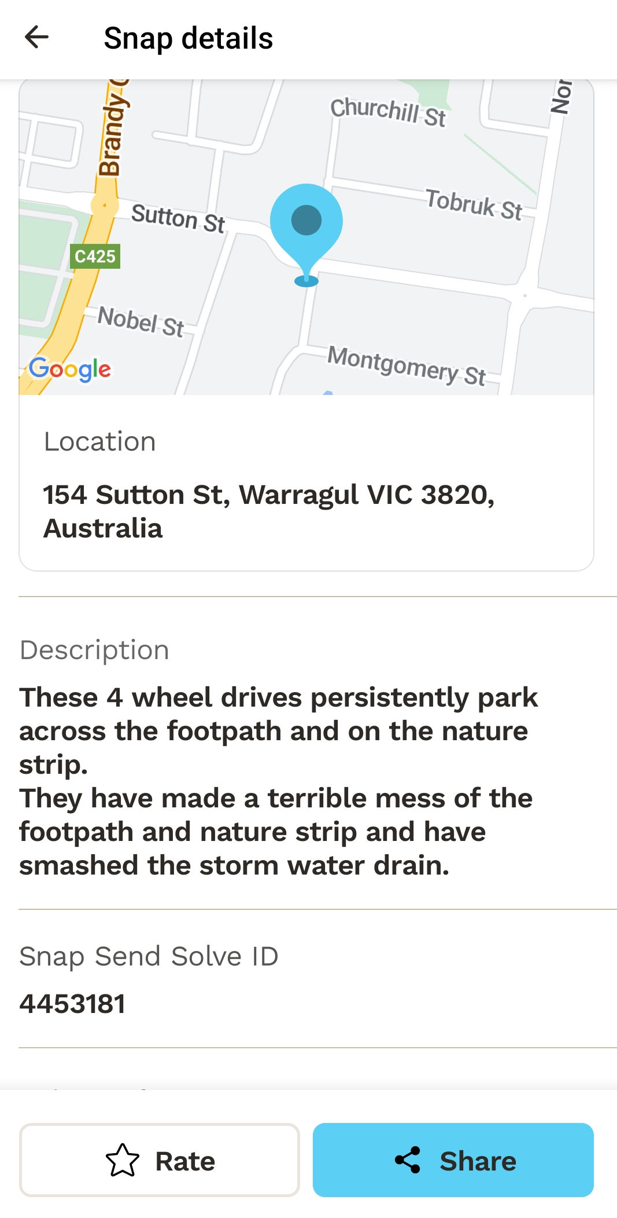
Submitting a complaint.
When I wish to submit a complaint I take a photo or photos of the problem.
They like you if possible to take in the photo a land mark or sign post.
When I get home where I have Wi Fi I open the App and put my photos in it, because the photos have location details in you can see on the map the problems location, if it is not exact enough you can move the blue pointer so that it is exactly correct.
You then have to write a short description of the problem.
You then choose from a list choose who you want the report to be sent to.

Slide 11
BEFORE AND AFTER.

Slide 12
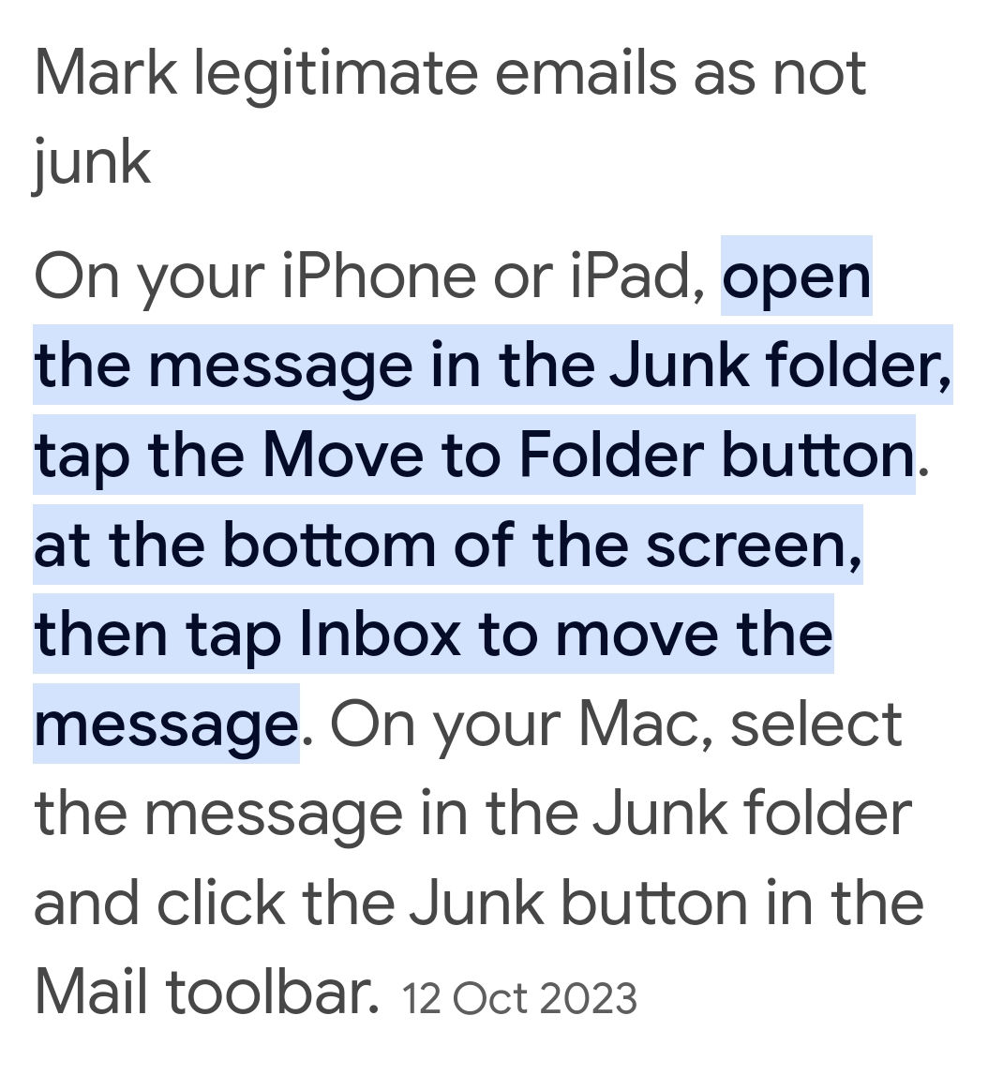
Apple Help.
Tell you email software that the file that it put in Spam or Junk is NOT Spam or Junk.
Your device should remember that sender for next time.

Slide 13
Apple Help.
Open a document sent as an attachment sent to your email.
How to Open and Save a Document Received via e-mail (iPad/iPhone) by Turner Time Management (youtube.com) Click on the blue link.
This is mainly to help people that do not have Microsoft Office on there Ipad.

Slide 14
Android phone back up contacts.

Slide 15
Time for someone to tell us about their favourite app on their phone.

Slide 16
What will we do for our June meeting ?
Some one volunteer to demonstrate something.
Otto has a demonstration to do.

